Slide 1
Bazele inteligenței artificiale
Laborator – Grigore Ionuț

Slide 2


today’s lab

Slide 3
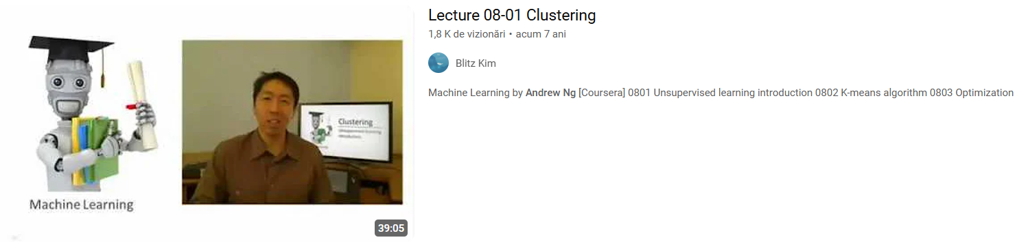
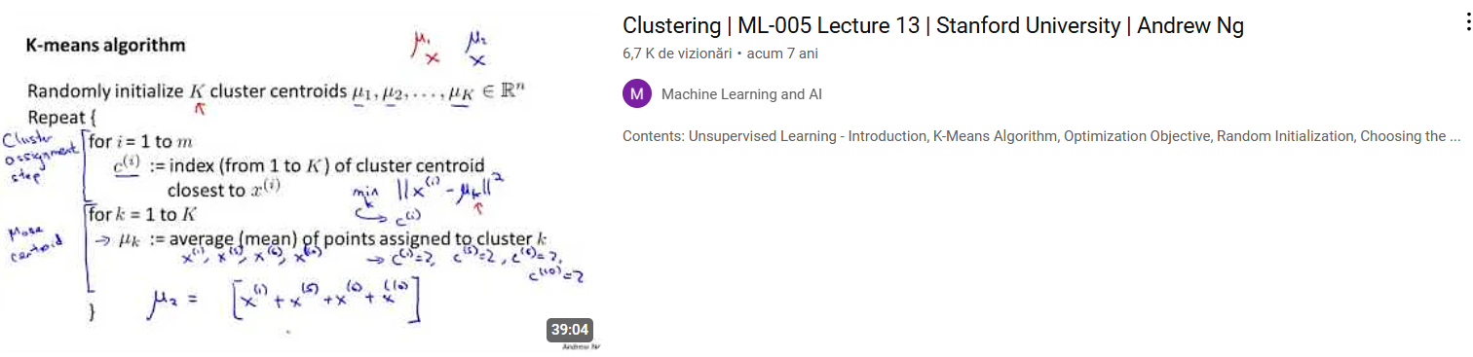

Slide 4
Content
Clustering - overview
K-means clustering
Agglomerative clustering
DBSCAN
Evaluating clustering methods

Slide 5
1) Clustering

Slide 6
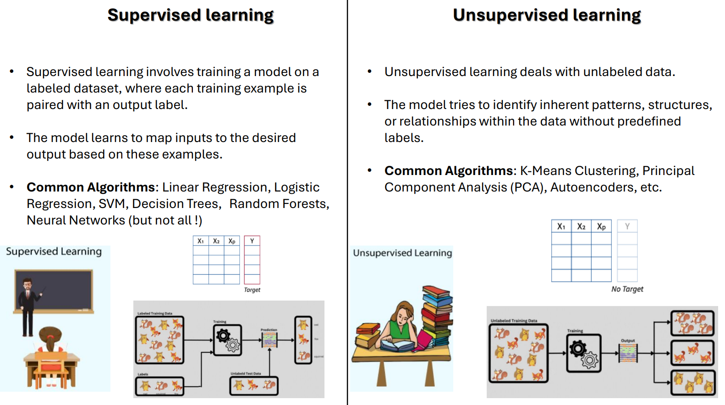
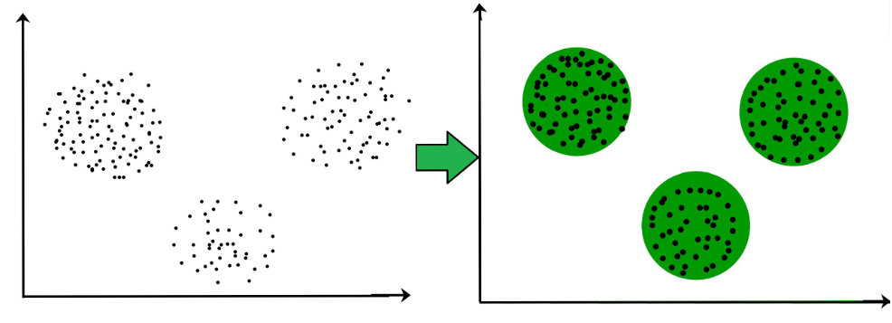
clustering grouping similar objects together into clusters
it’s an unsupervised task
the goal of clustering:
from lab 1 ☺

Slide 7
2) K-means clustering

Slide 8
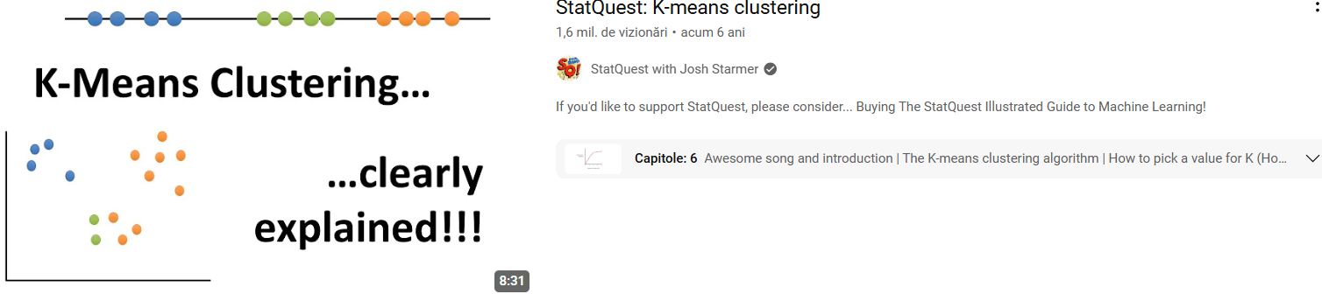

Slide 9
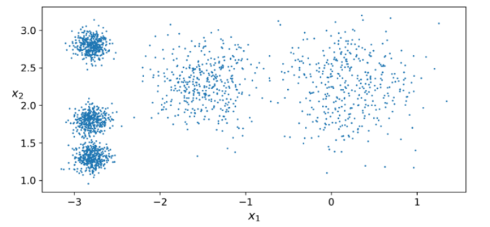
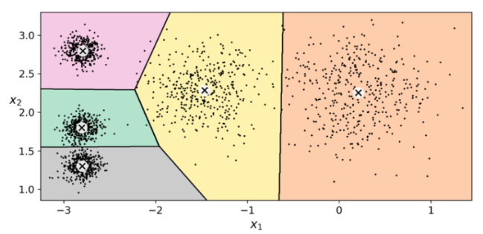
we can see here 5 blobs of points
scope of K-means: find the center of each blob
for a new point, we assign it to the closest blob/cluster

Slide 10
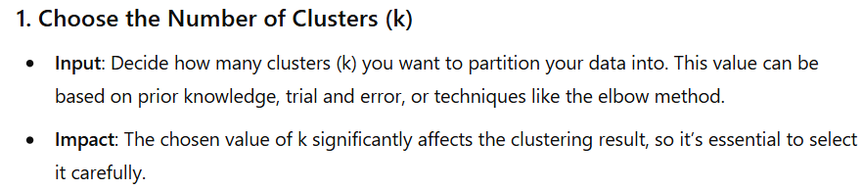
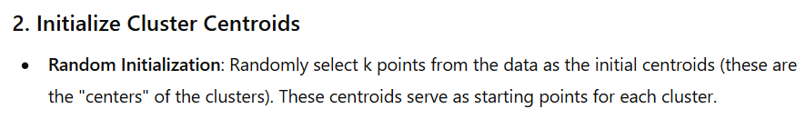
K-means steps

Slide 11
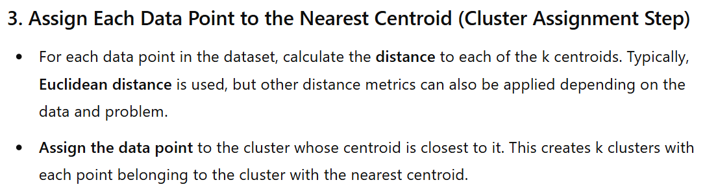
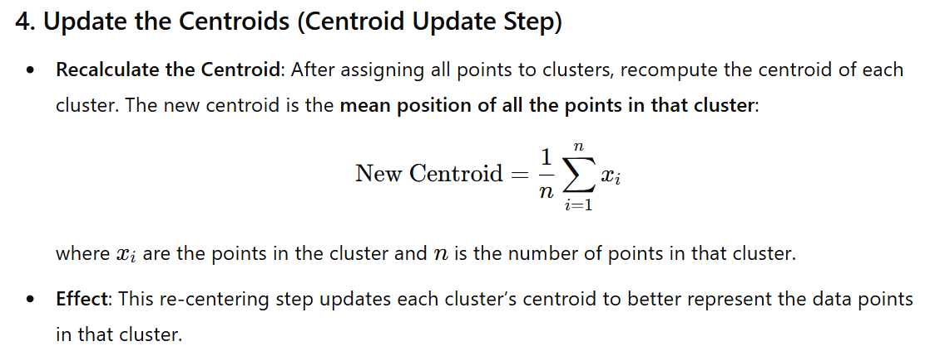

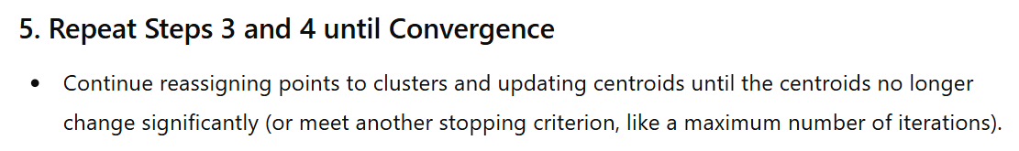

Slide 12
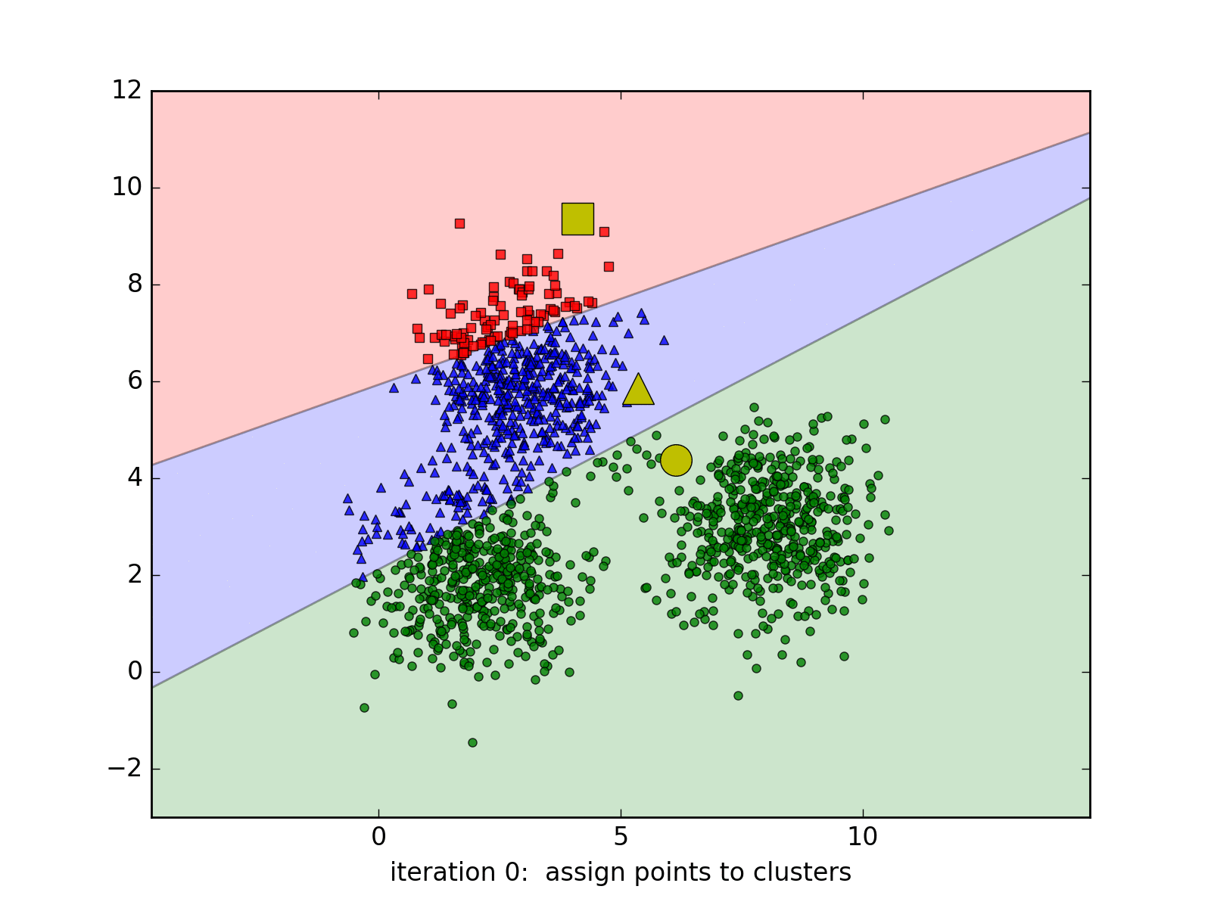

Slide 13
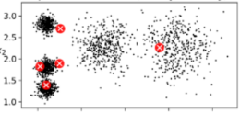
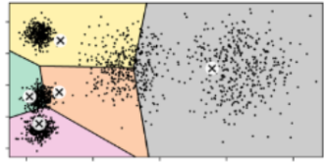
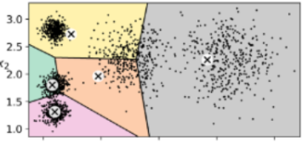
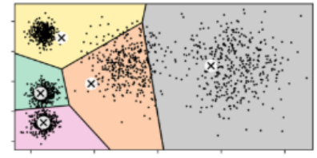
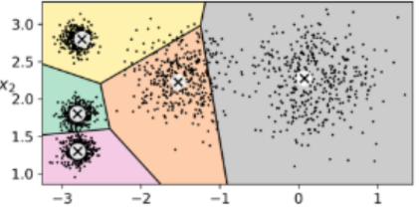
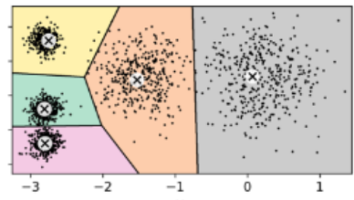






randomly initialize cluster centroids
assign points to clusters
update the centroids
assign points to clusters
update the centroids
assign points to clusters

Slide 14
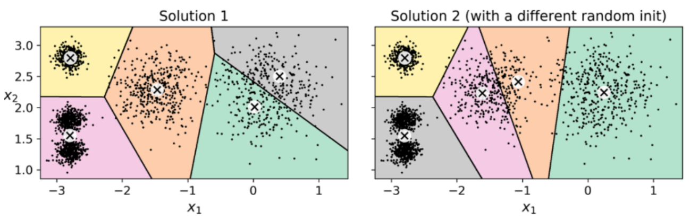



NOTE:
2 bad solutions
K-means is very sensitive to random initialization of the cluster centroids !
SOLUTIONS:
run K-means multiple times with different random initializations and keep the best solution (according to the metrics we will discuss in the following slides)
use K-means++ which introduces a smarter initialization of the cluster centroids

Slide 15

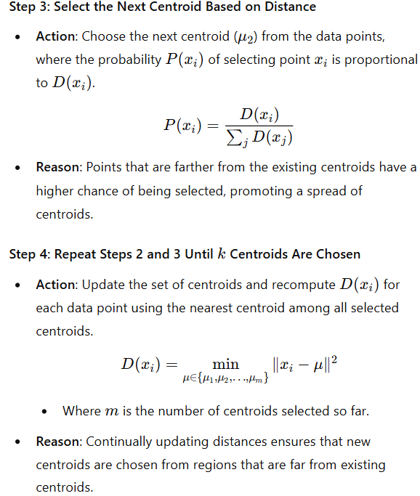
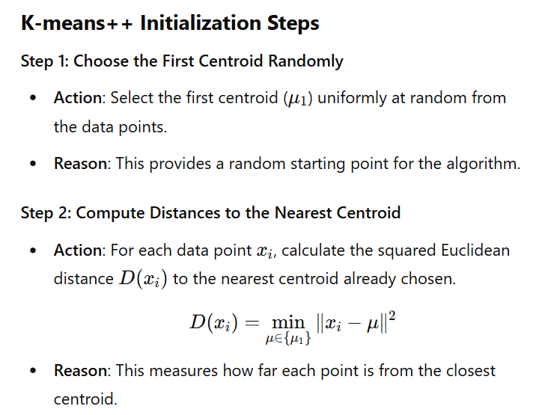

Slide 16
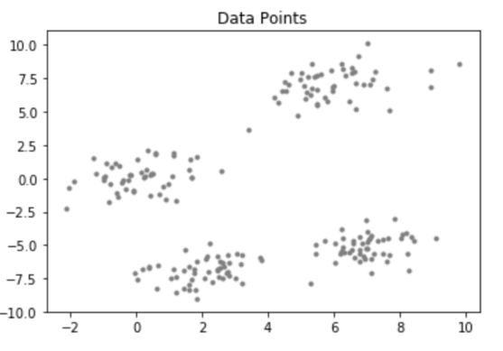
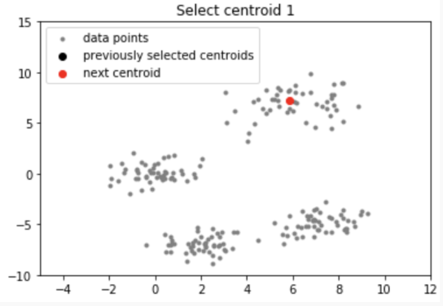
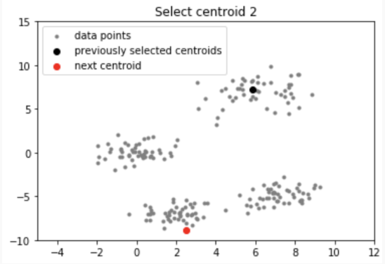
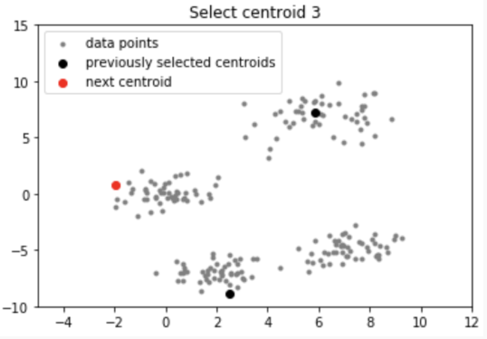
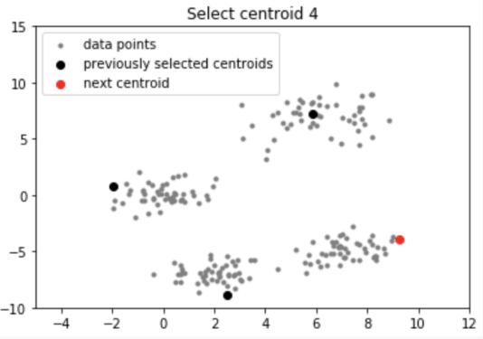

Slide 17
How do we choose the optimal k?

Slide 18
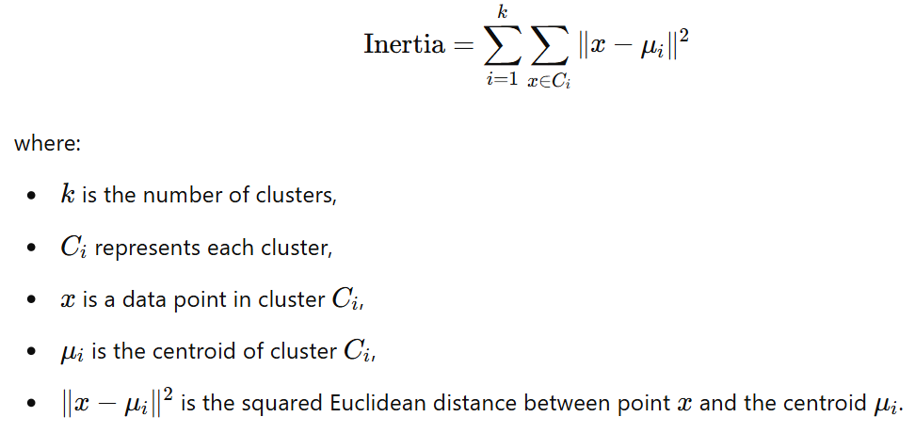
We have 2 performance metrics:
1) inertia
2) silhouette score
1)
Inertia: it’s the sum of squared distances between each data point and its assigned cluster’s centroid

Slide 19
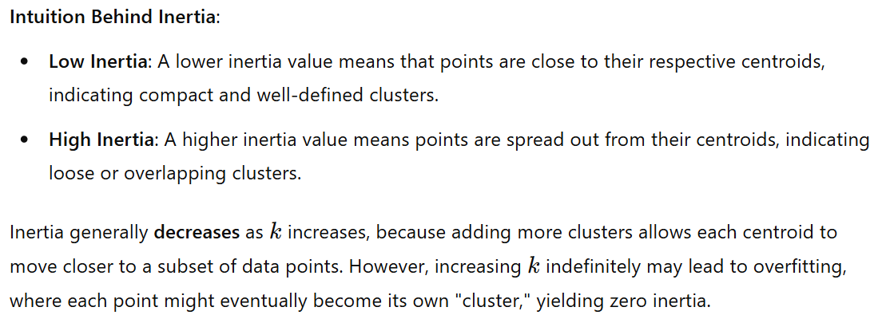
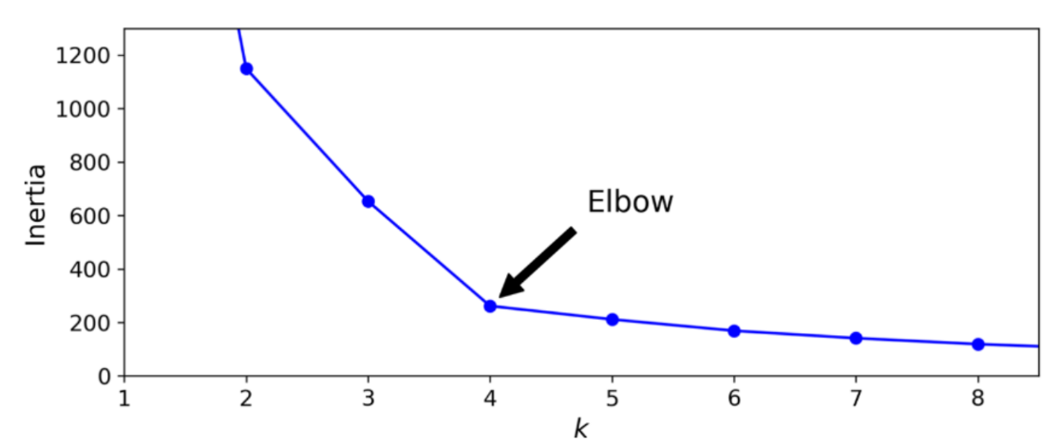
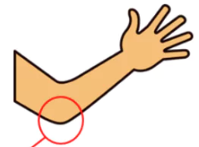


We choose the optimal number of clusters k using the elbow method !

Slide 20
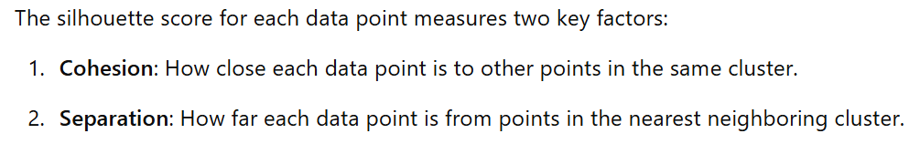
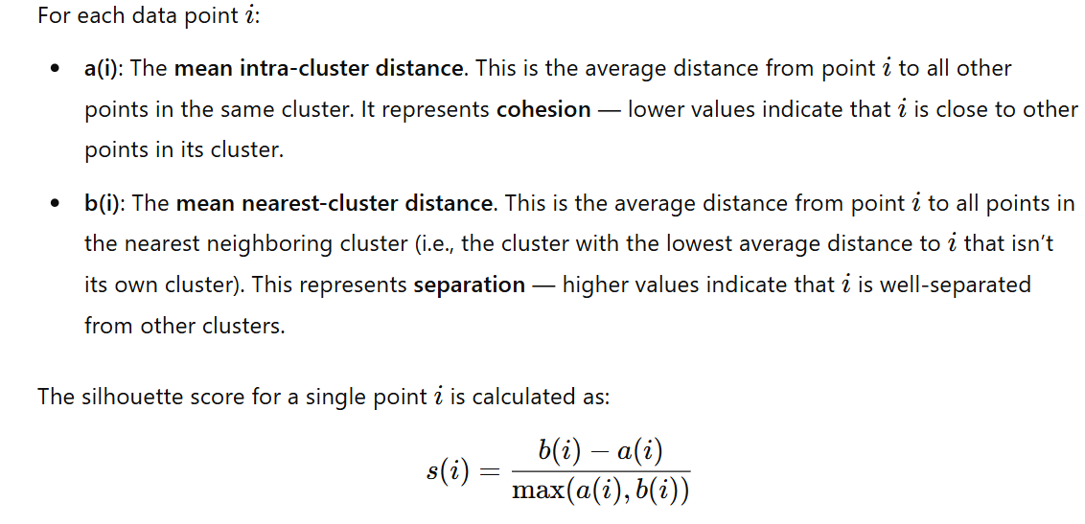


2)
silhouette score:

Slide 21
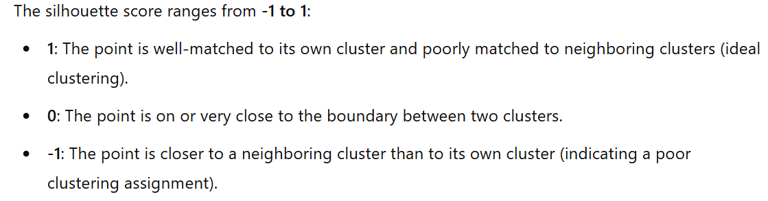
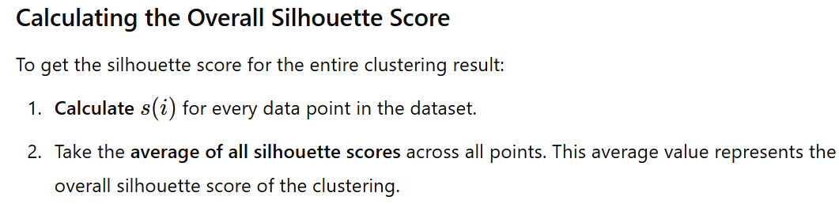
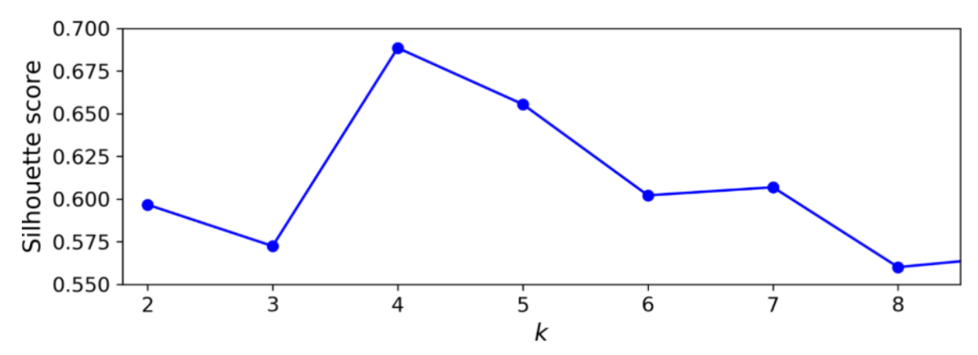



best choice (the highest score)

Slide 22
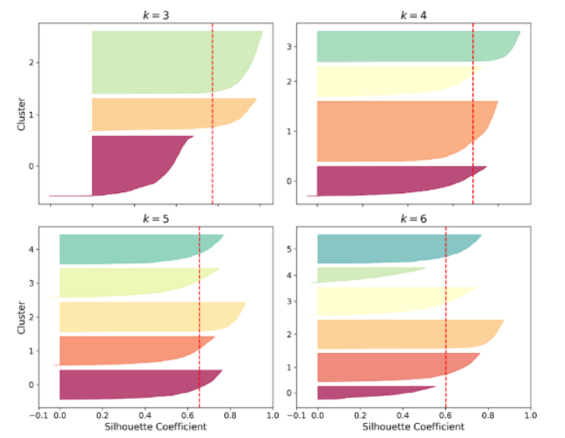
…or using a silhouette diagram…
bad option
good option
bad option
good option

Slide 23
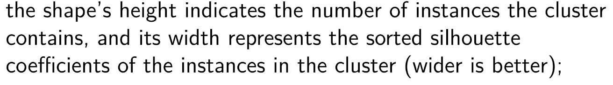



NOTES:

Slide 24
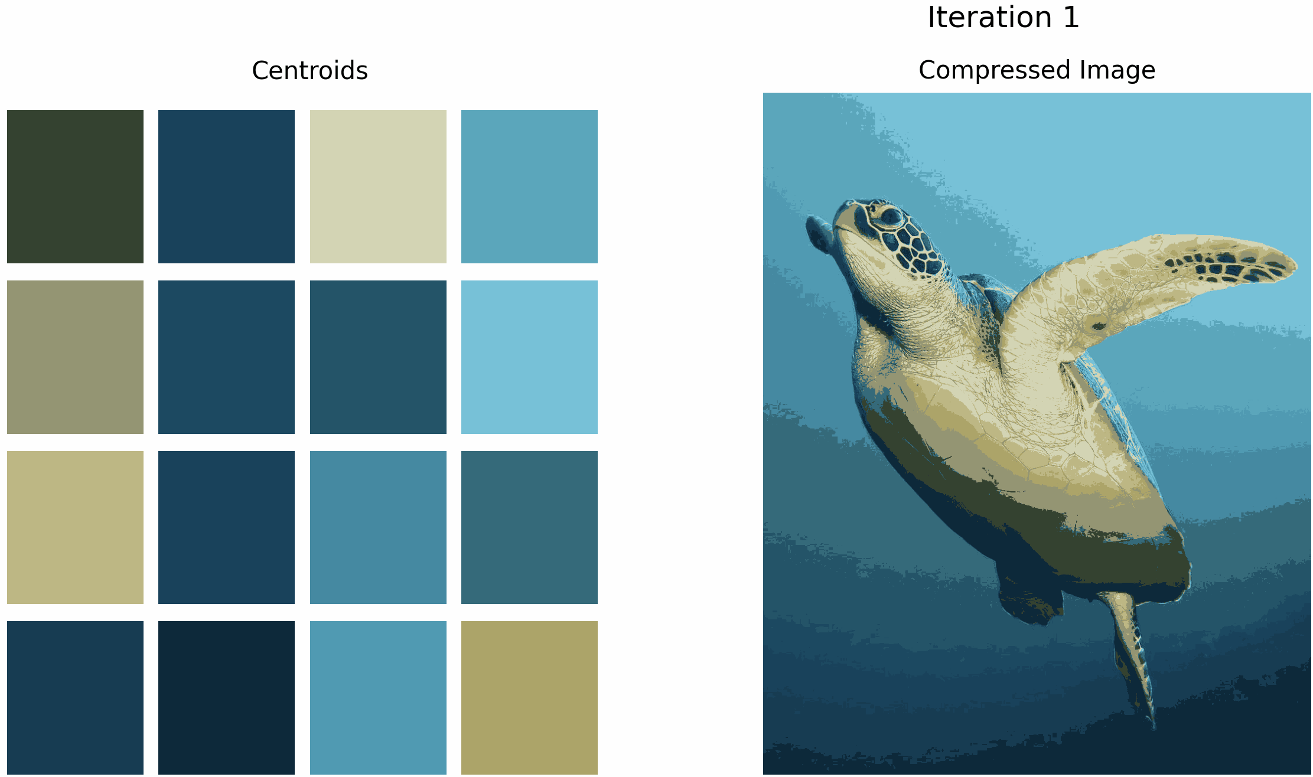
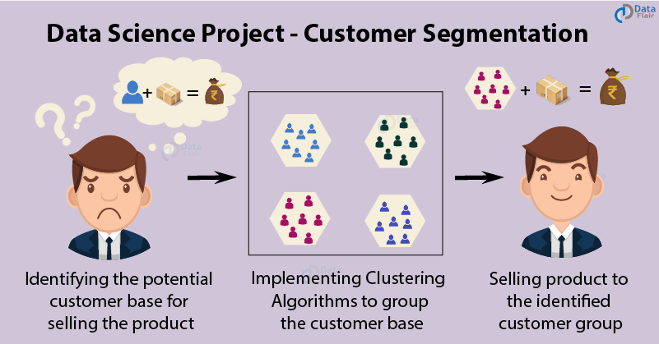

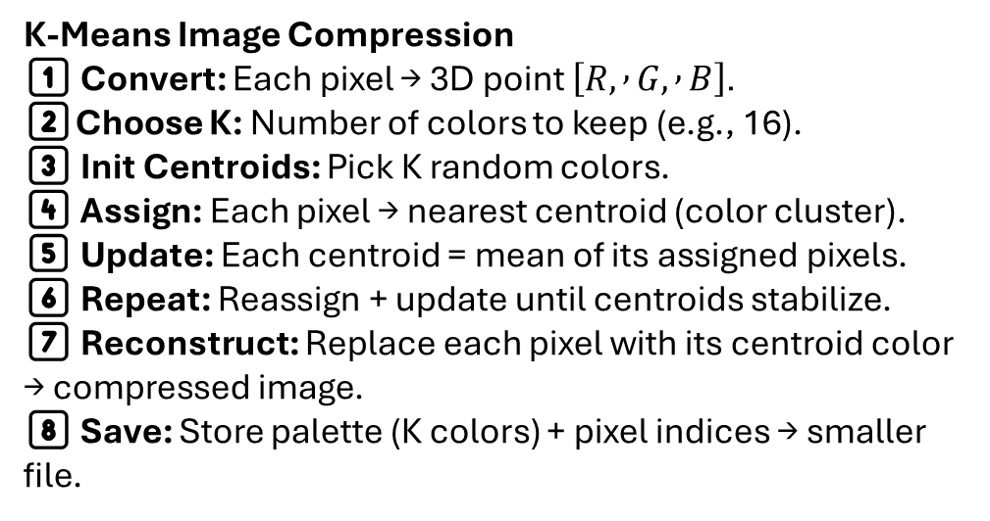
K-Means Image Compression
1️⃣ Convert: Each pixel → 3D point $\left[R, , G, , B\right]$.
2️⃣Choose K: Number of colors to keep (e.g., 16).
3️⃣ Init Centroids: Pick K random colors.
4️⃣ Assign: Each pixel → nearest centroid (color cluster).
5️⃣ Update: Each centroid = mean of its assigned pixels.
6️⃣ Repeat: Reassign + update until centroids stabilize.
7️⃣ Reconstruct: Replace each pixel with its centroid color → compressed image.
8️⃣ Save: Store palette (K colors) + pixel indices → smaller file.
Customer Segmentation with Clustering
Goal: Find groups of customers with similar behavior or preferences.
Input: Data like age, income, spending habits, region, etc.
Method: Apply clustering (e.g. K-Means)
Result: Each cluster = a distinct customer segment (e.g. “budget buyers”, “premium spenders”).

Slide 25
Code part

Slide 26
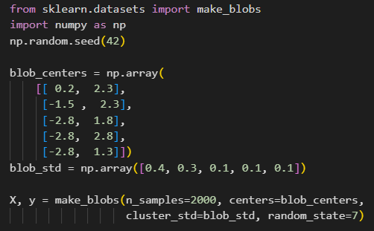
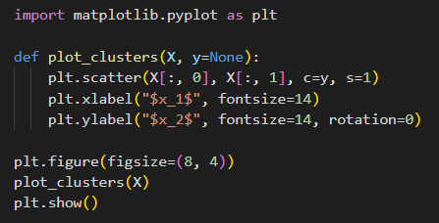
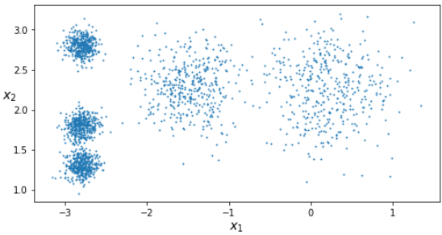

Slide 27
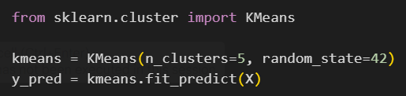
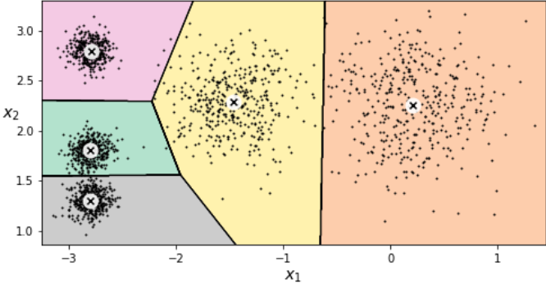
plot_decision_boundaries() function already done in lab☺

Slide 28
3) Agglomerative clustering

Slide 29
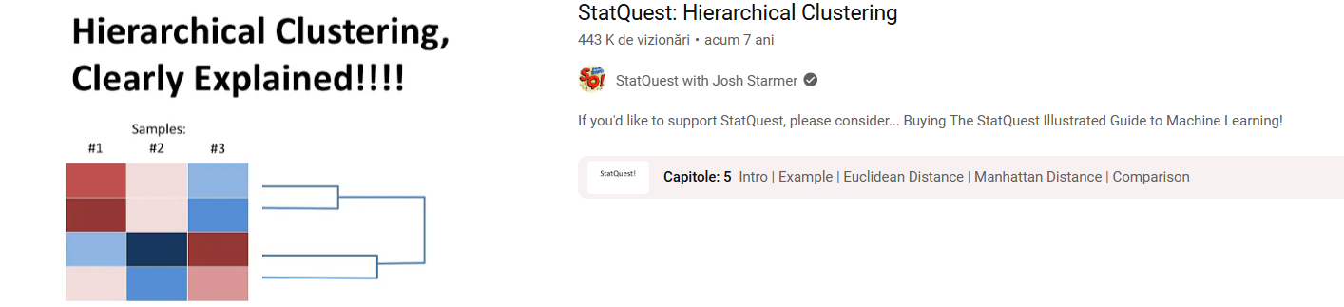

Slide 30
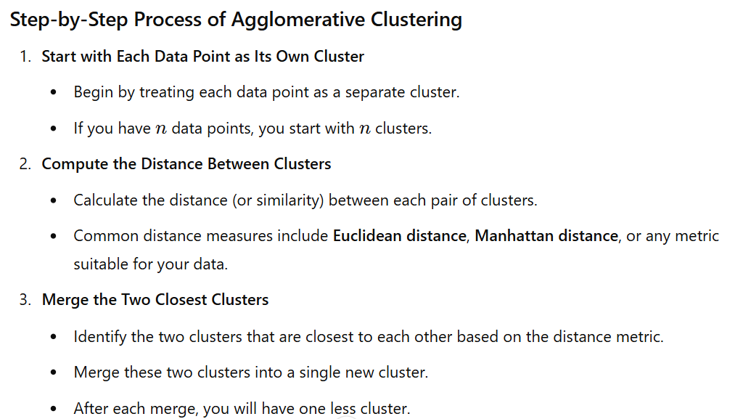
overall idea: it starts by declaring each point its own cluster, and then merges the 2 most similar clusters, until some stopping criteria is satisfied

Slide 31
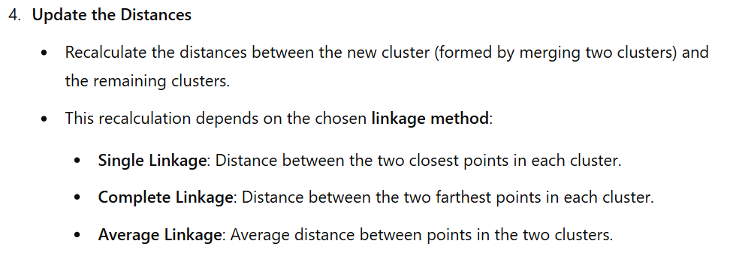
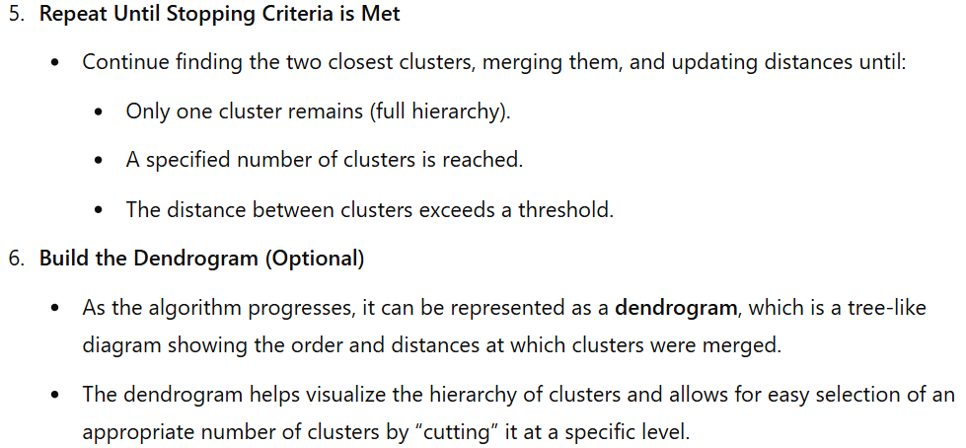

Slide 32







Slide 33



Slide 34



Slide 35
Code part

Slide 36



Slide 37



Slide 38
4) DBSCAN
(density-based spatial clustering of applications with noise)

Slide 39


Slide 40
unlike K-means, DBSCAN doesn’t require specifying the number of clusters beforehand and can identify clusters of arbitrary shapes, making it effective for tasks where the data contains noise or irregular clusters
DBSCAN relies on 2 parameters:
  ε: the maximum distance between 2 points for them to be considered part of the same cluster.
  m: the minimum number of points required within a distance of ε for a point to be considered a core point.
based on these parameters, DBSCAN classifies each point as:
  core point: a point with at least m points within its ε radius.
  border point: a point that isn’t a core point but is within ε of a core point.
  noise point: a point that isn’t a core point and isn’t within ε of any core point.

Slide 41



ε
ε
ε
m = 5

Slide 42






Don’t worry about it ☺
ε
m
ε
ε
m
m

Slide 43



ε
m

Slide 44
Code part

Slide 45



function from lab 3 ☺

Slide 46






plot_dbscan() function already done in lab☺
plot_dbscan() function already done in lab☺
7 clusters
noise points marked with red cross
2 clusters
no noise points

Slide 47
4) Evaluating clustering methods

Slide 48










2 methods:
  ARI (adjusted Rand index)
  NMI (normalized mutual information)
1)
  ARI (adjusted Rand index)
predicted clustering (U)
ground truth clustering (V)

Slide 49



full details and explanations for this example ☺

Slide 50

2)
  NMI (normalized mutual information)
https://course.ccs.neu.edu/cs6140sp15/7_locality_cluster/Assignment-6/NMI.pdf

Slide 51
Code part

Slide 52







Slide 53
Exercises

Slide 54


Slide 55




Solutions
NOTE: the algorithm="full" parameter was valid in older versions of scikit-learn, but it has since been deprecated. You can resolve this by replacing "full" with "lloyd"

Slide 56


Slide 57


Result:

Slide 58





NOTE: the append method was deprecated in recent versions of pandas. We can use pd.concat instead, which is now the recommended approach

Slide 59




Slide 60



Slide 61



Slide 62



Slide 63
Thank you !

